Slide 1
Trader Behavior Insights under Market Sentiment
Assignment -Junior Data Scientist

Slide 2
Objective
Analyze historical trader data + market sentiment (Fear/Greed).
Identify performance patterns & behaviors linked to profitability.

Slide 3
Data Overview
Datasets used:
Fear & Greed Index → Date, Sentiment (Fear/Greed).
Historical Trader Data → Trades (account, symbol, side, leverage, PnL…).
Preprocessing:
Cleaned timestamps
Merged on Date
Derived features: win rate, avg. leverage, PnL distribution

Slide 4
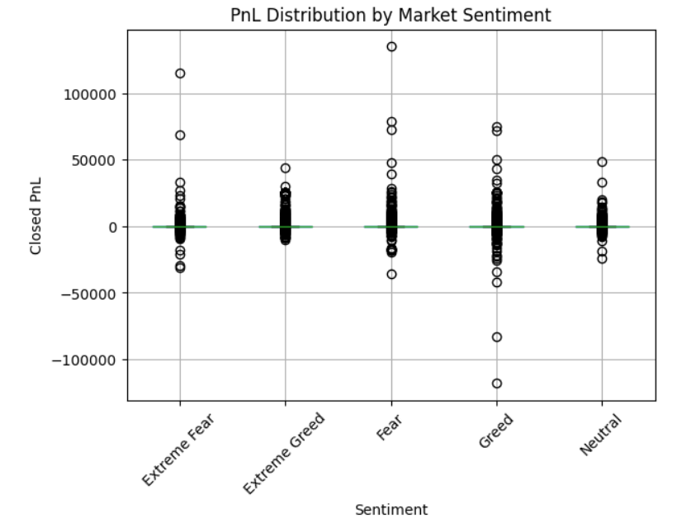
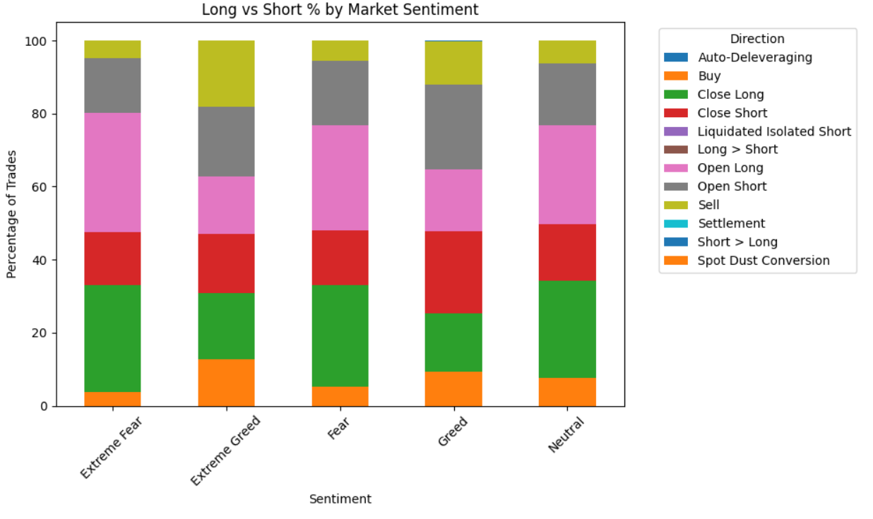
Key Analysis

Slide 5
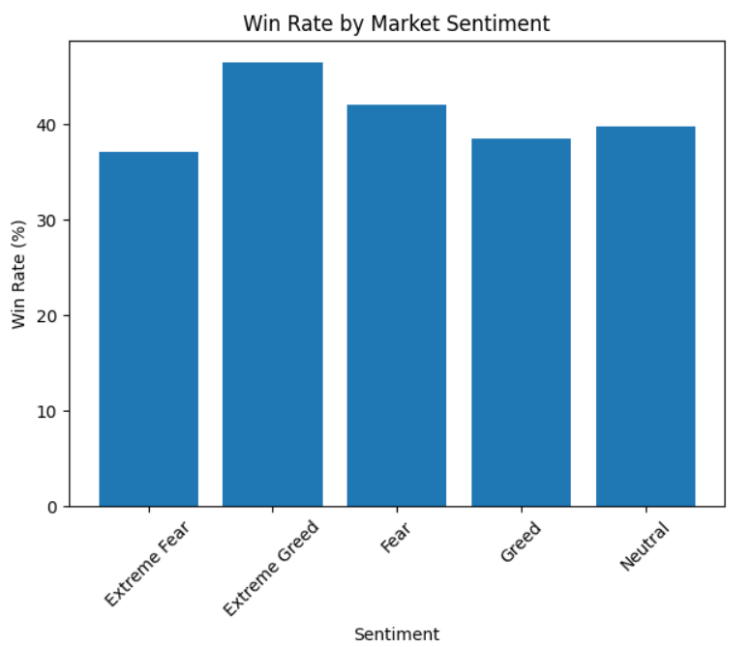
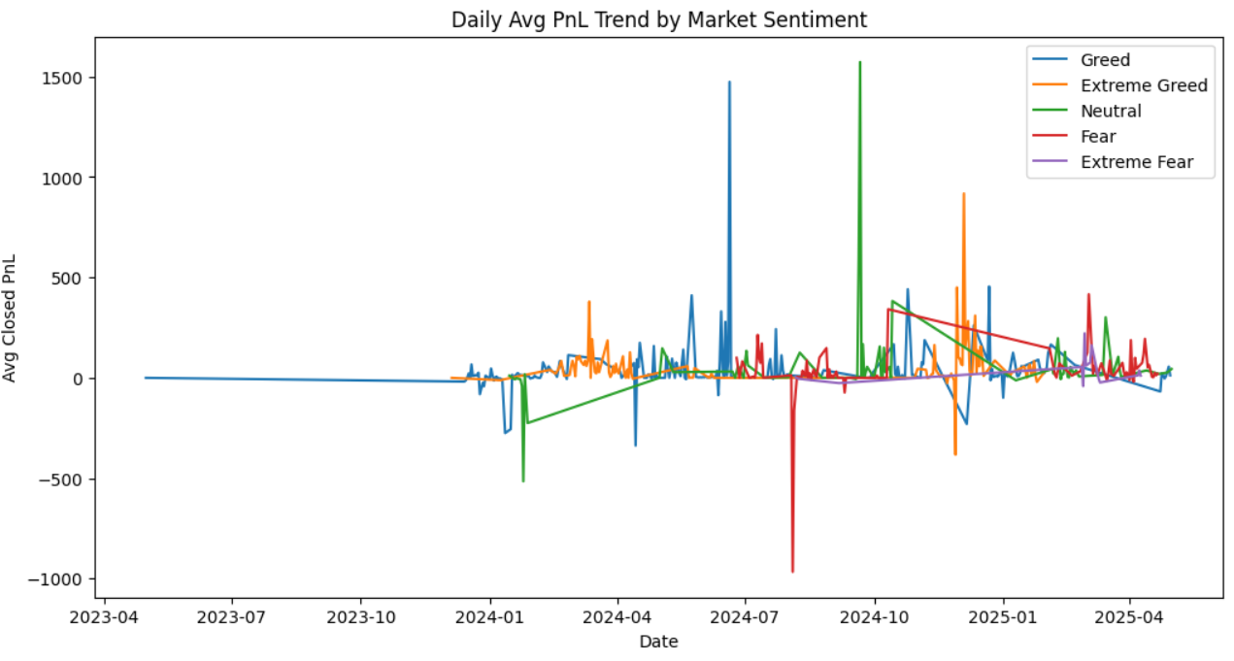

Slide 6
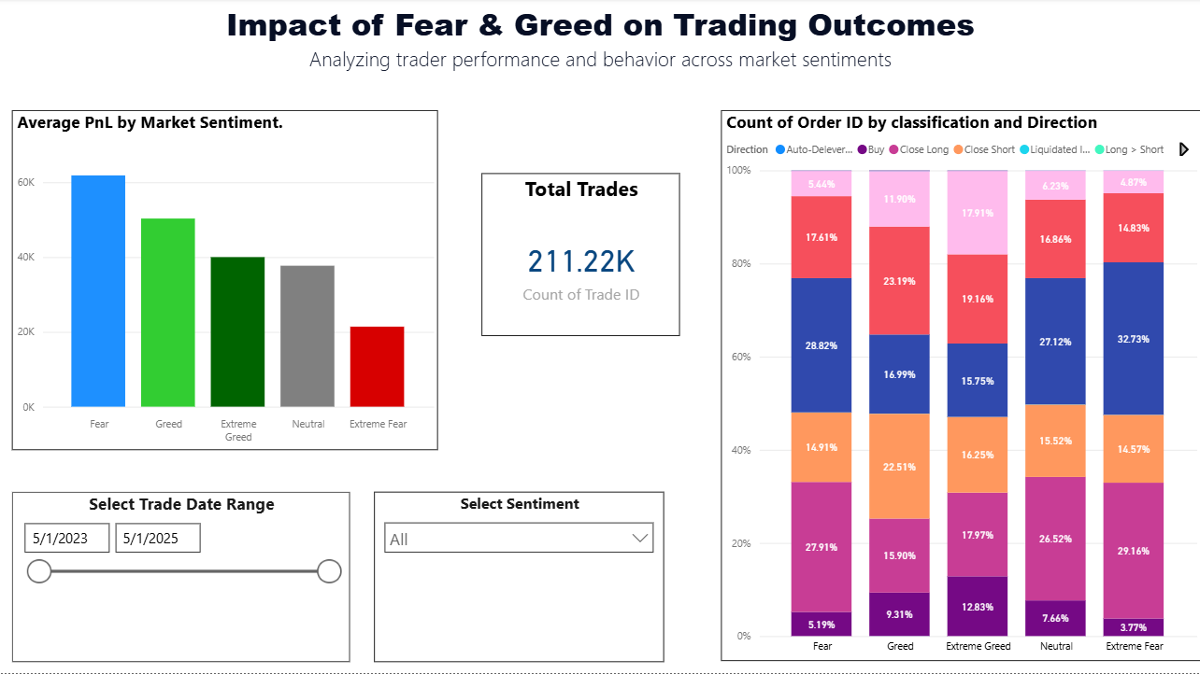

Slide 7
KEY INSIGHTS
PROFITABILITY
Highest average PnL occurs in Extreme Greed (~73).
Fear (~56) and Extreme Fear (~47) markets also show decent profits.
Lowest profits appear in Neutral (~32) and Greed (~36) markets.
Win Rate (fraction of profitable trades):
Best win rate is in Extreme Greed (46%).
Fear/Extreme Fear both hover around 39%.
Greed & Neutral ~40%
Trading Activity:
Most trades happen in Greed (~48k trades) and Fear (~47k trades).
Extreme Fear has the fewest trades (~5k)
Extreme Greed still sees high activity (~34k trades).

Slide 8
Conclusion & Next Steps

Slide 9
Conclusion
Market sentiment directly influences trader behavior & profitability.
Extreme Greed markets lead to the highest profitability despite similar win rates.
Fear reduces participation and lowers returns.
Neutral conditions are the least rewarding, highlighting inefficiency in sideways markets.

Slide 10
Next Steps
Build predictive models to forecast trader profitability using sentiment + trade features.
Use findings to design risk-adjusted strategies (e.g., reduce exposure in Neutral/Fear, exploit Extreme Greed runs).
Explore account-level clustering to identify consistent outperformers vs. underperformers.

Slide 11
About me
Shubhangi Kawale Aspiring Data Scientist | Trader Behavior Analyst
Background: Engineering Graduate | Data Analytics Projects & Internships
Skills:
Programming: Python (Pandas, NumPy, Matplotlib, Seaborn)
Data Analysis & Visualization: Jupyter, Power BI, Excel
Statistical Analysis & ML: Regression, Classification, Hypothesis Testing
Domain Knowledge: Crypto Markets, Trading Strategies, Market Sentiment
Portfolio: https://github.com/shubhangikawale2/Trader-Behavior-Insights
LinkedIn: https://www.linkedin.com/in/shubhangikawale/ Email: shubhangivkawale@gmail.com

Slide 12
THANK YOU

